Slide 1
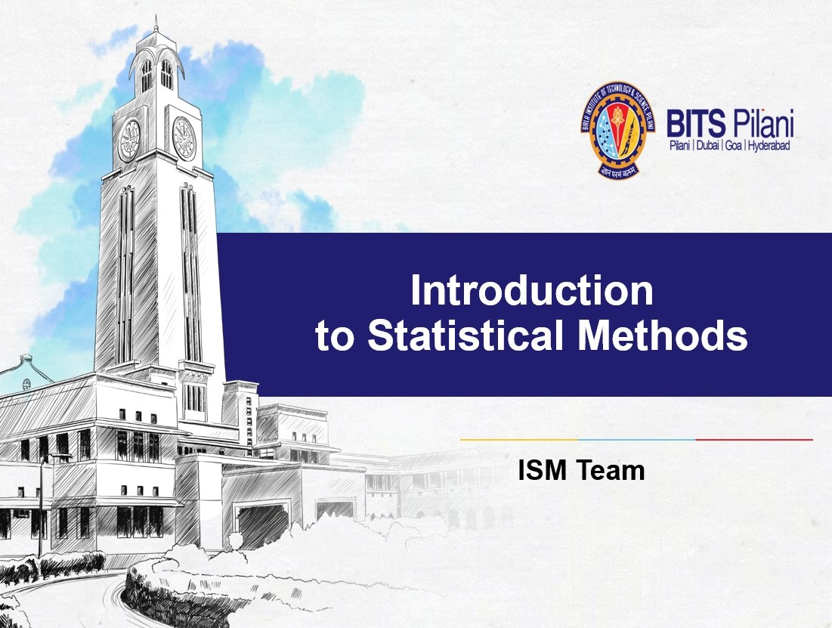


Slide 2


BITS Pilani
Sessions 15 Time Series Analysis
(9th Sep 2023)

Slide 3



Time Series

Slide 4

Statistical Methods for Data Science
Time Series Definition of Stochastic Process
Consider the sequence of random variables Y₀, Y₁, Y₂, … which forms a family of random variables {Y_{t}, t∈T } defined on a probability space (Ω, 𝓕, P)
where Ω - Sample space
ℱ - all collection of subsets A of Ω and P – probability measure
T – index set

Slide 5
Statistical Methods for Data Science
Time Series Definition of Stochastic Process
Index set:
The index set T is a collection of all time functions that can result from random experiment, usually the index T denote time. Y_{t} are independent and identically distributed (iid) random variables with
mean µ_{t} and variance σ ². Each realization of this
t
process gives an ensemble or a data set.
iid rvs: if each random variable has the same probability distribution as the others and all are mutually independent

Slide 6
Statistical Methods for Data Science
Time Series Definition of Stochastic Process
Examples of index sets:
T = (-∞, ∞) or T = [0, ∞). In this case Y_{t} is a continuous time stochastic process.
T = {0, ±1, ±2, ….} or T = {0, 1, 2, …}. In this case Y_{t} is a discrete time stochastic process.
We use uppercase letter {Y_{t} } to describe the process. A time series,
{Y_{t} } is a realization or sample function from a certain process.
We use information from a time series to estimate parameters and properties of process {Y_{t} }.

Slide 7
Statistical Methods for Data Science
Time Series Definition of Stochastic Process
Y_{t} represents random quantity at time t
In general, the value Y_{t} might depend on the quantity Y_{t-1} at time t-1, or even the value Y_{s} for other times s < t.

Slide 8
Statistical Methods for Data Science
Time Series Probability distribution of the process
For any stochastic process with index set T, its probability distribution function is uniquely determined by its finite dimensional distributions.
The k dimensional distribution function of a process is defined by
^{𝐹F}𝑡₁,$_{𝑡2,}…,$_{𝑡𝑘}
= 𝑃(𝑌_{𝑡1} ≤ 𝑦_{𝑡1} , 𝑌_{𝑡2} ≤ 𝑦_{𝑡2} , … , 𝑌_{𝑡𝑘} )
for any t₁, t₂, …,t_{k} ∈ T and any real numbers y₁, …, y_{k} .
The distribution function tells us everything we need to know about the process {Y_{t} }.
.

Slide 9
Statistical Methods for Data Science
Time Series Definition of Stochastic Process
In stochastic time series,
Y_{t}, t∈Z = {0, ±1, ±2, …}
is a family of random variables, Y_{t} denoting the value of the characteristic of interest at time t.
Thus, Y = (y₁, y₂, … , y_{n})′ is seen as a realized value of the random vector Y = (Y₁, Y₂, …,Y_{n})′ with joint probability density function f_{Y}(y).

Slide 10
Statistical Methods for Data Science
Time Series Definition of Stochastic Process
The joint distribution function of a finite random variables
{Y_{t} , … Y_{t} }, t₁ < t₂ <…< t_{n}
1 n
from the collection {Y_{t}, t∈T} is
F_{Yt1, … Yt} (y₁, …, y_{n}) = P[Y_{t} ≤ y_{t} , …, P[Y_{t} ≤ y_{t} ],
n 1 1 n n
(y_{t1} ,…, y_{t} ) ∈ R^{n}
n

Slide 11

Statistical Methods for Data Science
Time Series Stationary Stochastic Process in Time series
A special kind of stochastic process is based on the assumption that the process is in a particular state of equilibrium. This type of assumption is called stationarity.
A stochastic process is strictly stationary if its properties are unaffected by a change of origin.

Slide 12
Statistical Methods for Data Science
Time Series Moments of Stochastic Processes
We can describe a stochastic process via its moments, ie., E(Y_{t}), E(Y² ), E(Y , Y ), etc. We often use the first two
t t s
moments.
The mean function of the process is E(Y_{t}) = µ_{t}.
The variance function of the process is V(Y_{t}) = σ² .
t

Slide 13
Statistical Methods for Data Science
Time Series Moments of Stochastic Processes
The Covariance function between Y_{t}, and Y_{s} is Cov (Y_{t}, Y_{s}) = E((Y_{t} - µ_{t}) (Y_{s} - µ_{s}))
The Correlation function between Y_{t}, and Y_{s} is
₌ 𝐶𝑜𝑣 (𝑌_{𝑡}, 𝑌_{𝑠})
𝜌 𝑌_{𝑡}, 𝑌_{𝑠}
_{𝜎}2 _{𝜎}2
𝑡
𝑠
These moments are functions of time

Slide 14
Statistical Methods for Data Science
Time Series Stationary Stochastic Process in Time series
Thus, a time series stochastic process {Y_{t} , Y_{t} , … Y_{t} } is
1 2 k
said to be strictly stationary, if the joint distribution of k
observations Y_{t} , … Y_{t} made at time t₁, …, t_{k} is same as
1 k
that of k+h observations Y_{t1+} , Y_{t} , … Y_{t} made at time
h 2+h k+h
points t_{1+h}, …, t_{k+h} for any h. That is,
F_{Yt1, … Yt} (y_{t} , …, y_{t} ) = F_{Yt} (y_{t} , _{Yt} …, y )
k 1 k 1+h^{, Yt}2+h^{, … Yt}k+h 1+h 2+h^{, t}k+h

Slide 15
Statistical Methods for Data Science
Time Series Stationary Stochastic Process in Time series
If {Y_{t} } is a strictly stationary process and E(Y² ) < ∞ then, the mean
t
function is a constant and the variance function is also a constant.
Moreover, for a strictly stationary process with first two moments finite, the covariance function, and the correlation function depends only on the time difference s.
A trivial example of a strictly stationary process is a sequence of independent and identically distributed (iid) random variables.

Slide 16
Statistical Methods for Data Science
Time Series Stationary Stochastic Process in Time series
That is, F_{Yt1, … Ytk}(y_{t1}, …, y_{tk}) = F_{Yt1+h, … Ytk+h} (y_{t1+h}, …, y_{tk+h}) for all possible non-empty finite distinct sets
(t₁, …, t_{k}) and (t_{1+h}, …, t_{k+h}) in the index set T and all y_{t1}, …, y_{tk} in the range of random variables Y_{t}.
Note: For reliable prediction to be made, the time series should be stationary (No systematic change such as seasonality, trend i.e. only random fluctuations)

Slide 17
Statistical Methods for Data Science
Time Series Stochastic Process
Strict stationarity is too strong of a condition in practice. It is often difficult assumption to assess based on an observed time series Y₁,…,Y_{k}.
In time series analysis we often use a weaker sense of stationarity in terms of the moments of the process.
A process is said to be nth-order weakly stationary if all its joint
moments up to order n exists and are time invariant, i.e., independent of time origin.

Slide 18
Statistical Methods for Data Science
Time Series Stochastic Process
For example, a second-order weakly stationary process will have constant mean and variance, with the covariance and the correlation being functions of the time difference along.
A strictly stationary process with the first two moments finite is also a second-ordered weakly stationary. But a strictly stationary process may not have finite moments and therefore may not be weakly stationary.

Slide 19
Statistical Methods for Data Science
Time Series Stationary Stochastic Process in Time series
When k = 1, strict stationary implies that the pdf f(y_{t}) is the same for all t, is say f(y). The stochastic process f(y) has a constant mean
&
µ = E Y$ = . yf y dy
%&

Slide 20
Statistical Methods for Data Science
Time Series Stationary Stochastic Process in Time series
and a constant variance
/
𝜎² = 𝐸(𝑌_{𝑡} − 𝜇)²= ,(𝑦 − 𝜇)²f y dy
./
provided the mean and variance exists.

Slide 21
Statistical Methods for Data Science
Time Series Stationary Stochastic Process in Time series
The mean (μ) and variance (σ²) are estimated as
𝑛
1
𝜇! = 𝑥̅ = _{𝑛} ( 𝑦_{i}
i"1
𝑛
1
𝜎!
&
= 𝑆
&
= ((𝑦
−𝑦.)
&
𝑦
𝑦
𝑛
i
i"1

Slide 22
Statistical Methods for Data Science
Time Series Stationary Stochastic Process in Time series
Thus, a stationary process remains at equilibrium about a common mean value.
However, in industry, business (ex. Stock price) and economics many time series are better represented as non-stationary and in particular, having no natural mean.

Slide 23

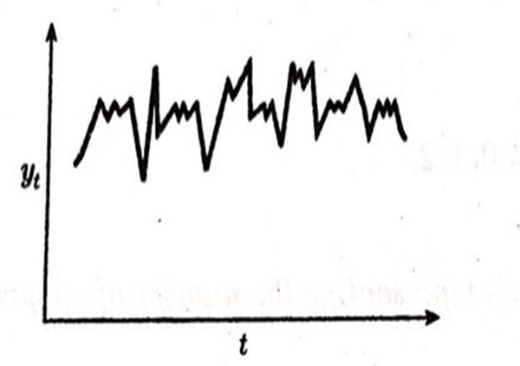
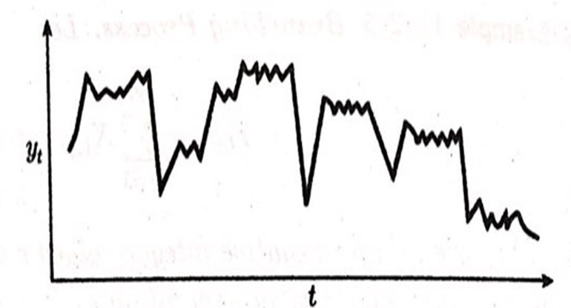
Statistical Methods for Data Science
Time Series Stationary Stochastic Process in Time series
Stationary time series
Non-stationary time series

Slide 24
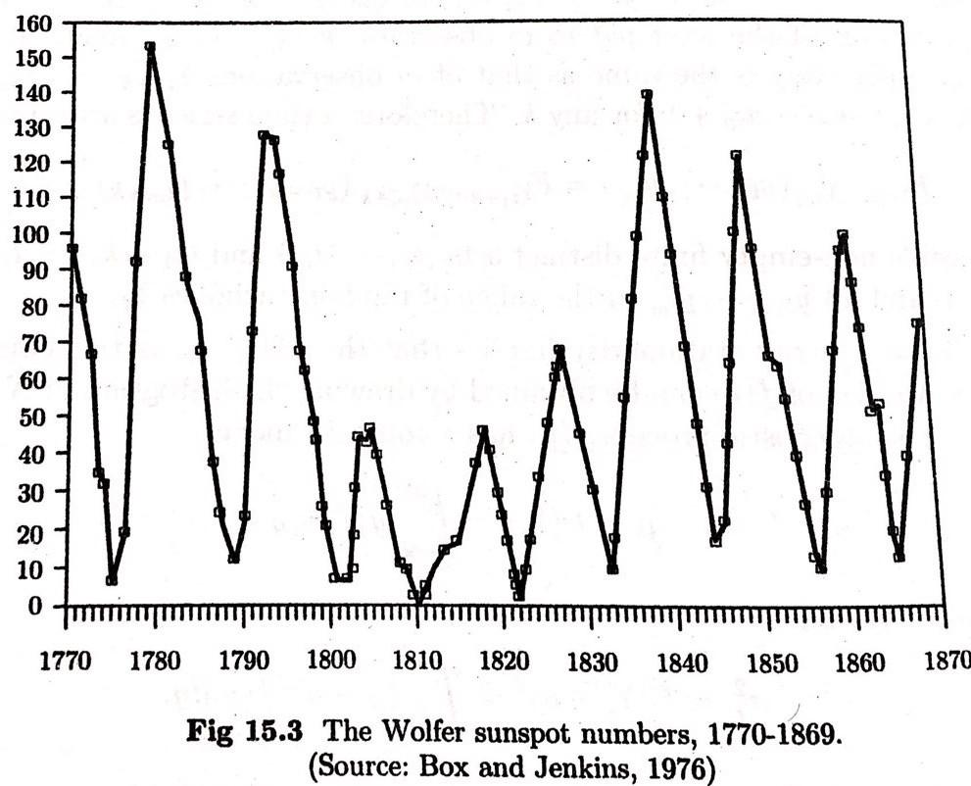
Statistical Methods for Data Science
Time Series Stationary Stochastic Process in Time series

Slide 25
Statistical Methods for Data Science
Time Series Stationary Stochastic Process in Time series
However, many non-stationary time series can be so modified that the reduced to time series obeys the original series.
The two main component which cause lack of stationarity are trend and seasonality. In fitting the stationary time series model, we therefore, assume that the trend and seasonality have been eliminated from the original series.

Slide 26
Statistical Methods for Data Science
Time Series Autocovariance
Stationarity implies that the joint distribution of pair of observations y_{t} , y_{t} viz.,
1 2
f(y_{t} , y_{t} ) = f(y_{t +h}, y_{t +h}) 1 2 1 2
for any integer h. That is, the joint distribution of any
pair of observations on time points which differ by a constant quantity is the same for such pairs.

Slide 27
Statistical Methods for Data Science
Time Series Autocovariance
Thus
, y_{t +h t} , y_{t} )
₂ ₂+h
have the same distribution.
The form of f(y_{t}, y_{t+h}) can be inferred by plotting values of (y_{t}, y_{t+h}); t = 1, 2, …., i.e., values of y_{t} separated by lag h.

Slide 28
Statistical Methods for Data Science
Time Series Autocovariance
Let {Y_{t}} be a Time Series with E {Y_{t} } < ∞. The mean function
2
of {Y_{t}} is µ_{y}(t) = E(Y_{t}).
The covariance function of {Y_{t}, Y_{t+h}} is
γ_{h}= Cov (Y_{t}, Y_{t+h}) = E[(Y_{t}-µ)(Y_{t+h}-µ)]
In general
γ_{y}(r, s) = Cov (Y_{r}, Y_{s}) = E[{Y_{r}-µ_{y}(r)}{Y_{s}-µ_{y}(s)}] for all integers r and s

Slide 29
Statistical Methods for Data Science
Time Series Autocovariance
Clearly, with h=0, in γ_{h}= Cov (Y_{t}, Y_{t+h}) = E[(Y_{t}-µ)(Y_{t+h}-µ)] γ₀= Cov (Y_{t}, Y_{t+0}) = E[(Y_{t}-µ)(Y_{t+0}-µ)] = σ²
y
𝛾' ≤ 𝛾₍, ∀ ℎ = 1, 2, …
because, 𝐶𝑜𝑣(𝑌_{𝑡'(}, 𝑌_{𝑡}) ≤ 𝑉 𝑌_{𝑡'(} 𝑉(𝑌_{𝑡})

Slide 30
Statistical Methods for Data Science
Time Series Autocovariance function
Let {Y_{t}} be a stationery Time Series.
The Autocovariance Function (ACVF) of {Y_{t}} at lag h is
γ_{y}(t+h, t) = Cov (Y_{t+h}, Y_{t}).
The Autocorrelation Function (ACF) of {Y_{t}} at lag h is
₌ γ₎ ₌ Cov(Y_{$')}, Y$) _{, 𝝆𝟎 = 𝟏}
ρ
)
γ*
_{σ}2

Slide 31
Statistical Methods for Data Science
Time Series Autocorrelation
Correlation: measure of relationship between two variables are related
Direction of the relationship (Negative, Zero, and/ or positive
Degree/ Extent of relationship

Slide 32
Statistical Methods for Data Science
Time Series Autocorrelation
The autocorrelation measures the degree of relationship of the same variable between the observation at the current time period and the observations at the prior time periods.
It measures how the lagged version of the value of a variable is related to the original version of it in time series.

Slide 33
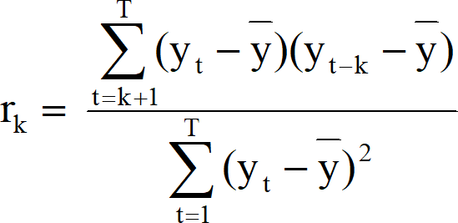
Statistical Methods for Data Science
Time Series Autocorrelation
The value of r_{k} can be written as
where T is the length of time series.

Slide 34
Statistical Methods for Data Science
Time Series Autocorrelation
Autocorrelation between (Y_{t}, Y_{t-1})
&
∑ 𝑌 − 𝑌
𝑌_{𝑡#1} − 𝑌&
𝑟 =
𝑡
1
∑ 𝑌_{𝑡} − 𝑌& $
Autocorrelation between (Y_{t}, Y_{t-2})
&
∑ 𝑌 − 𝑌
𝑌_{𝑡#$} − 𝑌&
𝑟 =
𝑡
$
∑ 𝑌_{𝑡} − 𝑌& $
– −
−
−
Autocorrelation between (Y_{t}, Y_{t-k})
&
∑ 𝑌 − 𝑌
𝑌_{𝑡#𝑘} − 𝑌&
𝑟 =
𝑡
𝑘
∑ 𝑌_{𝑡} − 𝑌& $

Slide 35
Statistical Methods for Data Science
Time Series Autocorrelation
There are several autocorrelation coefficients, corresponding to each panel in the lag plot. For example, r₁ measures the relationship
between Y_{t} and Y_{t−1}, r₂ measures the relationship between Y_{t} and Y_{t−2}, and so on rk measures the relationship between Y_{t} and Y_{t-k}.

Slide 36
Year | 2011 |  |  |  | 2012
Quarter | Q1 | Q2 | Q3 | Q4 | Q1 | Q2 | Q3 | Q4
Retail quarterly sale (million) (Yt) | 147772 | 154400 | 166188 | 170202 | 173264 | 175371 | 184957 | 186395
Year | 2013 |  |  |  | 2014
Quarter | Q1 | Q2 | Q3 | Q4 | Q1 | Q2 | Q3 | Q4
Retail quarterly sale (million) (Yt) | 191130 | 191213 | 195749 | 198262 | 199980 | 209566 | 212529 | 213754
Year | 2015 |  |  |  | 2016
Quarter | Q1 | Q2 | Q3 | Q4 | Q1 | Q2 | Q3 | Q4
Retail quarterly sale (million) (Yt) | 222124 | 224372 | 229871 | 236260 | 238044 | 244076 | 244944 | 245799
Year | 2017 |  |  |  | 2018
Quarter | Q1 | Q2 | Q3 | Q4 | Q1 | Q2
Retail quarterly sale (million) (Yt) | 251125 | 254557 | 255223 | 264793 | 265064 | 277282

Slide 37
Time | Value | Lag 1 | Lag 2 | Lag 3 | Lag 4 | Lag 5 | Lag 6 | Lag 7 | Lag 8 | Lag 9 | Lag 10
1 | 22
2 | 24 | 22
3 | 25 | 24 | 22
4 | 25 | 25 | 24 | 22
5 | 28 | 25 | 25 | 24 | 22
6 | 29 | 28 | 25 | 25 | 24 | 22
7 | 34 | 29 | 28 | 25 | 25 | 24 | 22
8 | 37 | 34 | 29 | 28 | 25 | 25 | 24 | 22
9 | 40 | 37 | 34 | 29 | 28 | 25 | 25 | 24 | 22
10 | 44 | 40 | 37 | 34 | 29 | 28 | 25 | 25 | 24 | 22
11 | 51 | 44 | 40 | 37 | 34 | 29 | 28 | 25 | 25 | 24 | 22
12 | 48 | 51 | 44 | 40 | 37 | 34 | 29 | 28 | 25 | 25 | 24
13 | 47 | 48 | 51 | 44 | 40 | 37 | 34 | 29 | 28 | 25 | 25
14 | 50 | 47 | 48 | 51 | 44 | 40 | 37 | 34 | 29 | 28 | 25
15 | 51 | 50 | 47 | 48 | 51 | 44 | 40 | 37 | 34 | 29 | 28

Slide 38
95% of ACF spikes should be within ± ²
 | Autocorrelation
Lag 1 | 0.83174
Lag 2 | 0.65632
Lag 3 | 0.49105
Lag 4 | 0.27864
Lag 5 | 0.03103
Lag 6 | -0.1653
Lag 7 | -0.3037
Lag 8 | -0.401
Lag 9 | -0.4582
Lag 10 | -0.4505
1
𝑇
0.8
0.6
0.4
0.2
0
Lag 1
Lag 2
Lag 3
Lag 4
Lag 5
Lag 6
Lag 7
Lag 8
Lag 9 Lag 10
-0.2
-0.4
-0.6

Slide 39
Month/ Year | Retail quarterly sale (million) | Lag1 | Lag2 | Lag3 | Lag4 | Lag5 | Lag6
Q1 - 2011 | 147772
Q2 - 2011 | 154400 | 147772
Q3 - 2011 | 166188 | 154400 | 147772
Q4 - 2011 | 170202 | 166188 | 154400 | 147772
Q1 - 2012 | 173264 | 170202 | 166188 | 154400 | 147772
Q2 - 2012 | 175371 | 173264 | 170202 | 166188 | 154400 | 147772
Q3 - 2012 | 184957 | 175371 | 173264 | 170202 | 166188 | 154400 | 147772
Q4 - 2012 | 186395 | 184957 | 175371 | 173264 | 170202 | 166188 | 154400
Q1 - 2013 | 191130 | 186395 | 184957 | 175371 | 173264 | 170202 | 166188
Q2 - 2013 | 191213 | 191130 | 186395 | 184957 | 175371 | 173264 | 170202
Q3 - 2013 | 195749 | 191213 | 191130 | 186395 | 184957 | 175371 | 173264
Q4 - 2013 | 198262 | 195749 | 191213 | 191130 | 186395 | 184957 | 175371
Q1 - 2014 | 199980 | 198262 | 195749 | 191213 | 191130 | 186395 | 184957
Q2 - 2014 | 209566 | 199980 | 198262 | 195749 | 191213 | 191130 | 186395
Q3 - 2014 | 212529 | 209566 | 199980 | 198262 | 195749 | 191213 | 191130
Q4 - 2014 | 213754 | 212529 | 209566 | 199980 | 198262 | 195749 | 191213
Q1 - 2015 | 222124 | 213754 | 212529 | 209566 | 199980 | 198262 | 195749
Q2 - 2015 | 224372 | 222124 | 213754 | 212529 | 209566 | 199980 | 198262
Q3 - 2015 | 229871 | 224372 | 222124 | 213754 | 212529 | 209566 | 199980
Q4 - 2015 | 236260 | 229871 | 224372 | 222124 | 213754 | 212529 | 209566
Q1 - 2016 | 238044 | 236260 | 229871 | 224372 | 222124 | 213754 | 212529
Q2 - 2016 | 244076 | 238044 | 236260 | 229871 | 224372 | 222124 | 213754
Q3 - 2016 | 244944 | 244076 | 238044 | 236260 | 229871 | 224372 | 222124
Q4 - 2016 | 245799 | 244944 | 244076 | 238044 | 236260 | 229871 | 224372
Q1 - 2017 | 251125 | 245799 | 244944 | 244076 | 238044 | 236260 | 229871
Q2 - 2017 | 254557 | 251125 | 245799 | 244944 | 244076 | 238044 | 236260
Q3 - 2017 | 255223 | 254557 | 251125 | 245799 | 244944 | 244076 | 238044
Q4 - 2017 | 264793 | 255223 | 254557 | 251125 | 245799 | 244944 | 244076
Q1 - 2018 | 265064 | 264793 | 255223 | 254557 | 251125 | 245799 | 244944

Slide 40
1.00000
0.87413
0.80000
0.77038
0.67408
0.60000
0.58895
0.49961
0.40745
0.40000
0.33113
0.25055
0.20000
0.16761
0.08688
0.00769
0.00000
Lag 1
Lag 2
Lag 3
Lag 4
Lag 5
Lag 6
Lag 7
Lag 8
Lag 9
Lag 10 Lag 11 Lag 12 Lag 13
-0.06849
-0.20000
-0.14020

Slide 41



Trend: Autocorrelation for small lags tend to be large and positive
Seasonal: Autocorrelation will be larger for smaller seasonal lags (at multiple seasonal frequency)

Slide 42
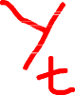

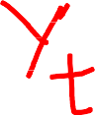
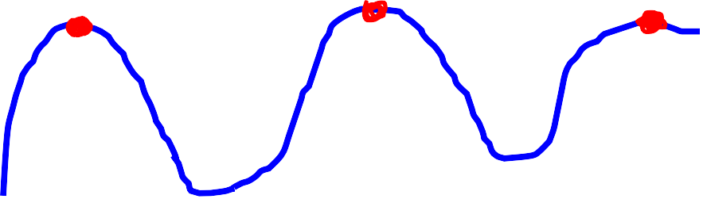




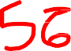

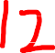

Trend: Autocorrelation for small lags tend to be large and positive
Seasonal: Autocorrelation will be larger for smaller seasonal lags (at multiple seasonal frequency)

Slide 43

Seasonal series

Slide 44
Statistical Methods for Data Science
Time Series White Noise
Time series that show no autocorrelation are called white noise. That is, if the variables are
independent and identically distributed with a mean of zero. This means that all variables have the same variance (σ²) and each value has a zero correlation with all other values in the series.

Slide 45
Statistical Methods for Data Science
Time Series White Noise
A white noise called white when it has the same intensity at every frequency. Its name is derived by analogy to light, which
is called "white" when it contains all visible frequencies noise.
The term noise, in this context, came from signal processing where it was used to refer to unwanted electrical or electromagnetic energy that degrades the quality of signals and data

Slide 46
Statistical Methods for Data Science
Time Series White Noise
For white noise series, we expect each autocorrelation to be close to zero. Of course, they
will not be exactly equal to zero as there is some
random variation. For a white noise series, we expect 95% of the spikes in the ACF to lie
within ±2/√T where T is the length of the time series.

Slide 47
Statistical Methods for Data Science
Time Series White Noise
It is common to plot these bounds on a graph of the
ACF (the blue dashed lines above). If one or more large spikes are outside these bounds, or if substantially more than 5% of spikes are outside these bounds, then the series is probably not white noise

Slide 48
White Noise series
Time series that shows no autocorrelation
± 2
95% of ACF spikes should be within
𝑇
2
If more than 5% of ACF spikes are outside ±
, then the series is not white
noise.
𝑇
Example: If T = 50, then
+ 2.8
± 2
2
= ± = ±2.8
𝑇
50
− 2.8

Slide 49
For T = 200, then
1.5000
± 2
2
= ± = ±2.8
1.0000
𝑇
200
0.5000
0.0000
lag 0
lag 1
lag 2
lag 3
lag 4
lag 5
lag 6
lag 7
lag 8
lag 9
lag 10
-0.5000
-1.0000
-1.5000

Slide 50
Statistical Methods for Data Science
Time Series Autocorrelation
Autocorrelation
0.5
0.3734
0.4
0.3
0.2
0.15
0.0922
0.1
0.0026
0
Yt-1
Yt-2
Yt-3
Yt-4
Yt-5
Yt-6
Yt-7
-0.1
-0.0582
-0.0444
-0.2
-0.2125
-0.3

Slide 51
Statistical Methods for Data Science
Time Series Test for Autocorrelation: Ljung-Box test
A statistical test of whether any group of autocorrelation of a time series are different from zero
A test for the overall randomness based on a number of lags
H₀: The series is random or white noise or independent and identically distributed (iid)
H₁: The series exhibits serial/ autocorrelation (non-random)
A small P-value (P < 0.05)
A large P-value (P > 0.05)
Reject H₀
Fail to Reject H₀
the series not white noise the series white noise
Note: Normally, P-value will be very large for white noise series

Slide 52
Statistical Methods for Data Science
Time Series Autocorrelation
Time | Value | lag 1 | lag 2 | lag 3 | lag 4 | lag 5
1 | 22 |  |  |  |  |  |  | Lag 1 | 0.8317
2 | 24 | 22 |  |  |  |  |  | Lag 2 | 0.6563
3 | 25 | 24 | 22 |  |  |  |  | Lag 3 | 0.4911
4 | 25 | 25 | 24 | 22 |  |  |  | Lag 4 | 0.2786
5 | 28 | 25 | 25 | 24 | 22 |  |  | Lag 5 | 0.0310
6 | 29 | 28 | 25 | 25 | 24 | 22 |  | Autocorrelation ^{0.9} 0.831742243 0.8 _{0.7} 0.656324582 ^{0.6} 0.491050119 0.5 0.4 _{0.3} 0.278639618 0.2 ^{0.1} 0.031026253 0 Lag 1 Lag 2 Lag 3 Lag 4 Lag 5
7 | 34 | 29 | 28 | 25 | 25 | 24
8 | 37 | 34 | 29 | 28 | 25 | 25
9 | 40 | 37 | 34 | 29 | 28 | 25
10 | 44 | 40 | 37 | 34 | 29 | 28
11 | 51 | 44 | 40 | 37 | 34 | 29
12 | 48 | 51 | 44 | 40 | 37 | 34
13 | 47 | 48 | 51 | 44 | 40 | 37
14 | 50 | 47 | 48 | 51 | 44 | 40
15 | 51 | 50 | 47 | 48 | 51 | 44

Slide 53
Statistical Methods for Data Science
Time Series Partial Autocorrelation Function (PACF)
The correlation between the observation at two time points given that we consider both observations are correlated to observations at other time periods.
– Example: Today’s stock price can be correlated to the day before yesterday and yesterday can also be correlated to the day before yesterday. Then PACF of yesterday is the ”real” correlation between today and yesterday after taking out the influence of the day before yesterday.

Slide 54
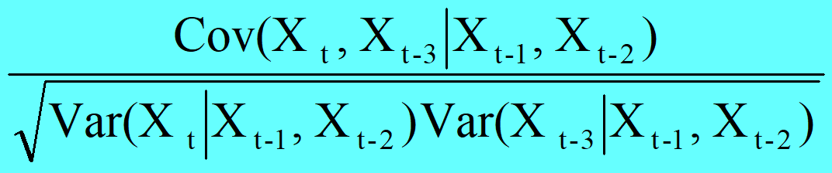
Statistical Methods for Data Science
Time Series Partial – Autocorrelation Function (PACF)
The partial correlation between two variables is a conditional correlation taking into account their dependence on all other remaining variables
Eg. A third order (lag) partial autocorrelation is
The first order PACF & ACF are same

Slide 55
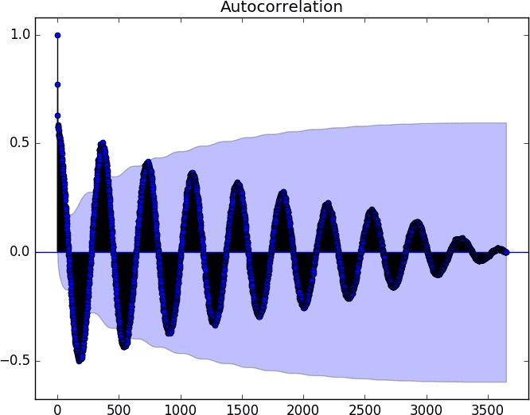
Statistical Methods for Data Science
Time Series Correlogram

Slide 56
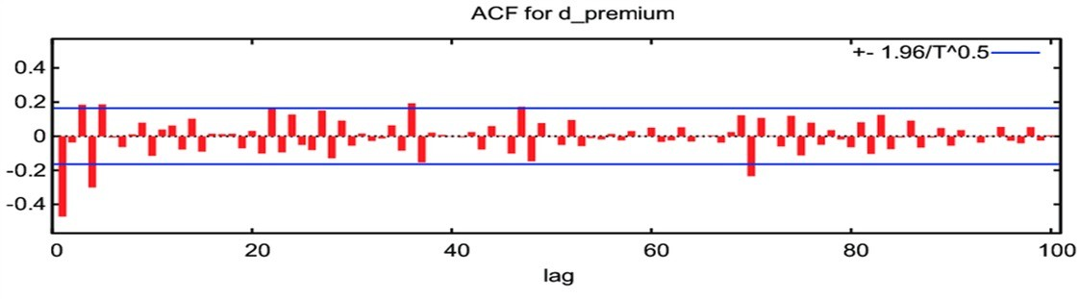
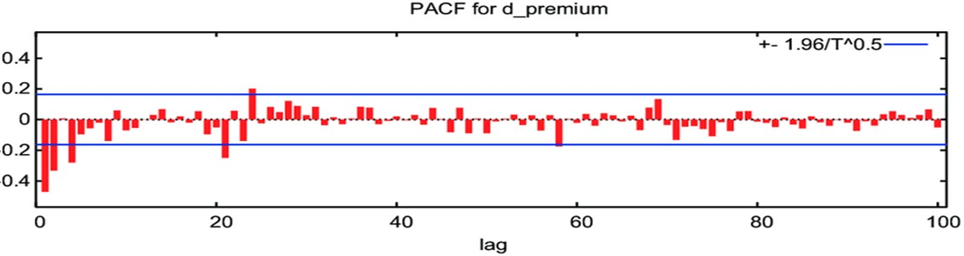

Slide 57
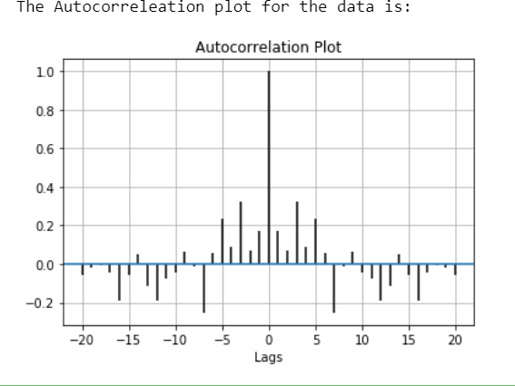
Statistical Methods for Data Science
Time Series Correlogram

Slide 58
Statistical Methods for Data Science
Time Series Autoregressive (AR) models
An autoregressive (AR) model is a representation of some type of random process; used to describe certain time-varying processes. The autoregressive model specifies that the output variable depends linearly on its own previous values and on a stochastic (random) error term; thus the model is in the form of a stochastic difference equation.

Slide 59
Statistical Methods for Data Science
Time Series Autoregressive (AR) models
The Autoregressive model of order p denoted by AR
(p) is given by
𝑌_{𝑡} = 𝑐_{𝑡} + ∅₁𝑌_{𝑡*1} + ∅&𝑌_{𝑡*&} + ⋯ + ∅_{𝑝}𝑌_{𝑡*𝑝} +𝜀_{𝑡}
where ϕ₁, ϕ₂, ϕ₃, … ϕ_{p} are the parameter of the model; c is constant and Ɛ_{t} is the white noise.

Slide 60
Ti m e
1 . 2 0 0 1
2 . 2 0 0 1
3 . 2 0 0 1
4 . 2 0 0 1
5 . 2 0 0 1
6 . 2 0 0 1
7 . 2 0 0 1
8 . 2 0 0 1
9 . 2 0 0 1
1 0 . 2 0 0 1
1 1 . 2 0 0 1
1 2 . 2 0 0 1
1 . 2 0 0 2
2 . 2 0 0 2
3 . 2 0 0 2
4 . 2 0 0 2
5 . 2 0 0 2
6 . 2 0 0 2
D efl ec t i o n
!2 1 $
!5 & 4
!$ 5
!1 5
1 4 1
1 1 5
!4 2 (
!$ & ( 2 ( $
!$ $ )
!4 $ 1
1 * 4
!2 2 (
!5 1 $
1 5 4
!1 2 5
!5 5 *
* 2
l ag 1
!2 1 $
!5 & 4
!$ 5
!1 5
1 4 1
1 1 5
!4 2 (
!$ & ( 2 ( $
!$ $ )
!4 $ 1
1 * 4
!2 2 (
!5 1 $
1 5 4
!1 2 5
!5 5 *
l ag 2
!2 1 $
!5 & 4
!$ 5
!1 5
1 4 1
1 1 5
!4 2 (
!$ & ( 2 ( $
!$ $ )
!4 $ 1
1 * 4
!2 2 (
!5 1 $
1 5 4
!1 2 5
l ag 3
!2 1 $
!5 & 4
!$ 5
!1 5
1 4 1
1 1 5
!4 2 (
!$ & ( 2 ( $
!$ $ )
!4 $ 1
1 * 4
!2 2 (
!5 1 $
1 5 4
l ag 4
l ag 5
l ag 6
l ag 7
l ag 8
l ag 9
l ag 1 0
!2 1 $
!5 & 4
!$ 5
!1 5
1 4 1
1 1 5
!4 2 (
!$ & ( 2 ( $
!$ $ )
!4 $ 1
1 * 4
!2 2 (
!5 1 $
!2 1 $
!5 & 4
!$ 5
!1 5
1 4 1
1 1 5
!4 2 (
!$ & ( 2 ( $
!$ $ )
!4 $ 1
1 * 4
!2 2 (
!2 1 $
!5 & 4
!$ 5
!1 5
1 4 1
1 1 5
!4 2 (
!$ & ( 2 ( $
!$ $ )
!4 $ 1
1 * 4
!2 1 $
!5 & 4
!$ 5
!1 5
1 4 1
1 1 5
!4 2 (
!$ & ( 2 ( $
!$ $ )
!4 $ 1
!2 1 $
!5 & 4
!$ 5
!1 5
1 4 1
1 1 5
!4 2 (
!$ & ( 2 ( $
!$ $ )
!2 1 $
!5 & 4
!$ 5
!1 5
1 4 1
1 1 5
!4 2 (
!$ & ( 2 ( $
!2 1 $
!5 & 4
!$ 5
!1 5
1 4 1
1 1 5
!4 2 (
!$ & (
7 . 2 0 0 2
!2 1
* 2
!5 5 *
!1 2 5
1 5 4
!5 1 $
!2 2 (
1 * 4
!4 $ 1
!$ $ )
2 ( $
8 . 2 0 0 2
9 . 2 0 0 2
1 0 . 2 0 0 2
1 1 . 2 0 0 2
1 2 . 2 0 0 2
1 . 2 0 0 3
2 . 2 0 0 3
3 . 2 0 0 3
4 . 2 0 0 3
5 . 2 0 0 3
6 . 2 0 0 3
7 . 2 0 0 3
8 . 2 0 0 3
9 . 2 0 0 3
1 0 . 2 0 0 3
1 1 . 2 0 0 3
1 2 . 2 0 0 3
1 . 2 0 0 4
2 . 2 0 0 4
!5 + *
!5 2
!2 1
* 2
!2 1
!5 + *
!5 2
* *
!5 4 $
!1 + 5
1 & 2
!4 5 +
!$ 4 &
2 ( 4
!$ ( (
!4 + 4
1 & 4
!1 ( +
!5 + 2
!)
) $
!5 4 1
!5 5 *
* 2
!2 1
!5 + *
!5 2
* *
!5 4 $
!1 + 5
1 & 2
!4 5 +
!$ 4 &
2 ( 4
!$ ( (
!4 + 4
1 & 4
!1 ( +
!5 + 2
!)
) $
!1 2 5
!5 5 *
1 5 4
!1 2 5
!5 5 *
* 2
!2 1
!5 + *
!5 2
* *
!5 4 $
!1 + 5
1 & 2
!4 5 +
!$ 4 &
2 ( 4
!$ ( (
!4 + 4
1 & 4
!1 ( +
!5 + 2
!5 1 $
1 5 4
!1 2 5
!5 5 *
* 2
!2 1
!5 + *
!5 2
* *
!5 4 $
!1 + 5
1 & 2
!4 5 +
!$ 4 &
2 ( 4
!$ ( (
!4 + 4
1 & 4
!1 ( +
!2 2 (
!5 1 $
1 * 4
!2 2 (
!5 1 $
1 5 4
!1 2 5
!5 5 *
* 2
!2 1
!5 + *
!5 2
* *
!5 4 $
!1 + 5
1 & 2
!4 5 +
!$ 4 &
2 ( 4
!$ ( (
!4 + 4
!4 $ 1
1 * 4
!2 2 (
!5 1 $
1 5 4
!1 2 5
!5 5 *
* 2
!2 1
!5 + *
!5 2
* *
!5 4 $
!1 + 5
1 & 2
!4 5 +
!$ 4 &
2 ( 4
!$ ( (
!$ $ )
!4 $ 1
* *
!5 4 $
!1 + 5
1 & 2
!4 5 +
!$ 4 &
2 ( 4
!$ ( (
!4 + 4
1 & 4
!1 ( +
!5 + 2
!)
) $
!5 4 1
!2 2 4
1 ) (
!5 + *
!5 2
* 2
!2 1
!5 + *
!5 2
* *
!5 4 $
!1 + 5
1 & 2
!4 5 +
!$ 4 &
2 ( 4
!$ ( (
!4 + 4
1 & 4
!1 ( +
!5 + 2
!)
1 5 4
!1 2 5
!5 5 *
* 2
!2 1
!5 + *
!5 2
* *
!5 4 $
!1 + 5
1 & 2
!4 5 +
!$ 4 &
2 ( 4
!$ ( (
!4 + 4
1 & 4
1 * 4
!2 2 (
!5 1 $
1 5 4
!1 2 5
!5 5 *
* 2
!2 1
!5 + *
!5 2
* *
!5 4 $
!1 + 5
1 & 2
!4 5 +
!$ 4 &
2 ( 4
* *
!5 4 $
!1 + 5
1 & 2
!4 5 +
!$ 4 &
2 ( 4
!$ ( (
!4 + 4
1 & 4
!1 ( +
!5 + 2
!)
) $
!5 4 1
!2 2 4
3 . 2 0 0 4
!4 2 (
1 ) (
!2 2 4
!5 4 1
) $
!)
!5 + 2
!1 ( +
1 & 4
!4 + 4
!$ ( (
4 . 2 0 0 4
5 . 2 0 0 4
6 . 2 0 0 4
7 . 2 0 0 4
8 . 2 0 0 4
9 . 2 0 0 4
1 0 . 2 0 0 4
1 1 . 2 0 0 4
1 2 . 2 0 0 4
1 . 2 0 0 5
2 . 2 0 0 5
3 . 2 0 0 5
4 . 2 0 0 5
5 . 2 0 0 5
6 . 2 0 0 5
7 . 2 0 0 5
8 . 2 0 0 5
9 . 2 0 0 5
1 0 . 2 0 0 5
!$ + 4
2 ( 1
!2 $ &
!5 $ 1
) $ 2 +
!5 & 4
!1 1 2
1 $ 1
!5 ( +
!2 5 4
1 * *
!$ 1 1
!4 * 5
1 4 $
!4 &
!5 + *
!* ( 1 $ &
!4 2 (
!$ + 4
1 ) (
!4 2 (
!$ + 4
2 ( 1
!2 $ &
!5 $ 1
) $ 2 +
!5 & 4
!1 1 2
1 $ 1
!5 ( +
!2 5 4
1 * *
!$ 1 1
!4 * 5
1 4 $
!4 &
!5 + *
!2 2 4
1 ) (
!4 2 (
!$ + 4
2 ( 1
!2 $ &
!5 $ 1
) $ 2 +
!5 & 4
!1 1 2
1 $ 1
!5 ( +
!2 5 4
1 * *
!$ 1 1
!4 * 5
1 4 $
!4 &
!5 4 1
!2 2 4
) $
!5 4 1
!2 2 4
1 ) (
!4 2 (
!$ + 4
2 ( 1
!2 $ &
!5 $ 1
) $ 2 +
!5 & 4
!1 1 2
1 $ 1
!5 ( +
!2 5 4
1 * *
!$ 1 1
!4 * 5
!)
) $
!5 4 1
!2 2 4
1 ) (
!4 2 (
!$ + 4
2 ( 1
!2 $ &
!5 $ 1
) $ 2 +
!5 & 4
!1 1 2
1 $ 1
!5 ( +
!2 5 4
1 * *
!$ 1 1
!5 + 2
!)
) $
!5 4 1
!2 2 4
1 ) (
!4 2 (
!$ + 4
2 ( 1
!2 $ &
!5 $ 1
) $ 2 +
!5 & 4
!1 1 2
1 $ 1
!5 ( +
!2 5 4
1 * *
!1 ( +
!5 + 2
!)
1 & 4
!1 ( +
!5 + 2
!)
) $
!5 4 1
!2 2 4
1 ) (
!4 2 (
!$ + 4
2 ( 1
!2 $ &
!5 $ 1
) $ 2 +
!5 & 4
!1 1 2
1 $ 1
!5 ( +
!4 + 4
1 & 4
!1 ( +
!5 + 2
!)
) $
!5 4 1
!2 2 4
1 ) (
!4 2 (
!$ + 4
2 ( 1
!2 $ &
!5 $ 1
) $ 2 +
!5 & 4
!1 1 2
1 $ 1
2 ( 1
!2 $ &
!5 $ 1
) $ 2 +
!5 & 4
!1 1 2
1 $ 1
!5 ( +
!2 5 4
1 * *
!$ 1 1
!4 * 5
1 4 $
!4 &
!5 + *
!* (
1 ) (
!4 2 (
!$ + 4
2 ( 1
!2 $ &
!5 $ 1
) $ 2 +
!5 & 4
!1 1 2
1 $ 1
!5 ( +
!2 5 4
1 * *
!$ 1 1
!4 * 5
1 4 $
) $
!5 4 1
!2 2 4
1 ) (
!4 2 (
!$ + 4
2 ( 1
!2 $ &
!5 $ 1
) $ 2 +
!5 & 4
!1 1 2
1 $ 1
!5 ( +
!2 5 4
1 1 . 2 0 0 5
!4 + 2
1 $ &
!* (
!5 + *
!4 &
1 4 $
!4 * 5
!$ 1 1
1 * *
!2 5 4
!5 ( +
1 2 . 2 0 0 5
1 . 2 0 0 6
2 . 2 0 0 6
3 . 2 0 0 6
4 . 2 0 0 6
5 . 2 0 0 6
6 . 2 0 0 6
7 . 2 0 0 6
8 . 2 0 0 6
9 . 2 0 0 6
1 0 . 2 0 0 6
1 1 . 2 0 0 6
1 2 . 2 0 0 6
1 . 2 0 0 7
2 . 2 0 0 7
3 . 2 0 0 7
4 . 2 0 0 7
5 . 2 0 0 7
6 . 2 0 0 7
!$ $ ) 2 ( 2
!2 ) +
!4 + +
1 & *
!1 2 4
!5 & )
1 +
4 )
!5 & )
!1 $ 5
1 & 2
!4 $ (
!4 2 2
1 + 2
!+ 4
!5 + +
!1 $
* 2
!4 + 2
!$ $ )
1 $ &
!4 + 2
!$ $ ) 2 ( 2
!2 ) +
!4 + +
1 & *
!1 2 4
!5 & )
1 +
4 )
!5 & )
!1 $ 5
1 & 2
!4 $ (
!4 2 2
1 + 2
!+ 4
!5 + +
!* ( 1 $ &
!4 + 2
!$ $ ) 2 ( 2
!2 ) +
!4 + +
1 & *
!1 2 4
!5 & )
1 +
4 )
!5 & )
!1 $ 5
1 & 2
!4 $ (
!4 2 2
1 + 2
!+ 4
!5 + *
!* (
!4 &
!5 + *
!* ( 1 $ &
!4 + 2
!$ $ ) 2 ( 2
!2 ) +
!4 + +
1 & *
!1 2 4
!5 & )
1 +
4 )
!5 & )
!1 $ 5
1 & 2
!4 $ (
!4 2 2
1 4 $
!4 &
!5 + *
!* ( 1 $ &
!4 + 2
!$ $ ) 2 ( 2
!2 ) +
!4 + +
1 & *
!1 2 4
!5 & )
1 +
4 )
!5 & )
!1 $ 5
1 & 2
!4 $ (
!4 * 5
1 4 $
!4 &
!5 + *
!* ( 1 $ &
!4 + 2
!$ $ ) 2 ( 2
!2 ) +
!4 + +
1 & *
!1 2 4
!5 & )
1 +
4 )
!5 & )
!1 $ 5
1 & 2
!$ 1 1
!4 * 5
1 * *
!$ 1 1
!4 * 5
1 4 $
!4 &
!5 + *
!* ( 1 $ &
!4 + 2
!$ $ ) 2 ( 2
!2 ) +
!4 + +
1 & *
!1 2 4
!5 & )
1 +
4 )
!5 & )
!2 5 4
1 * *
!$ 1 1
!4 * 5
1 4 $
!4 &
!5 + *
!* ( 1 $ &
!4 + 2
!$ $ ) 2 ( 2
!2 ) +
!4 + +
1 & *
!1 2 4
!5 & )
1 +
4 )
2 ( 2
!2 ) +
!4 + +
1 & *
!1 2 4
!5 & )
1 +
4 )
!5 & )
!1 $ 5
1 & 2
!4 $ (
!4 2 2
1 + 2
!+ 4
!5 + +
!1 $
1 $ &
!4 + 2
!$ $ ) 2 ( 2
!2 ) +
!4 + +
1 & *
!1 2 4
!5 & )
1 +
4 )
!5 & )
!1 $ 5
1 & 2
!4 $ (
!4 2 2
1 + 2
1 4 $
!4 &
!5 + *
!* ( 1 $ &
!4 + 2
!$ $ ) 2 ( 2
!2 ) +
!4 + +
1 & *
!1 2 4
!5 & )
1 +
4 )
!5 & )
!1 $ 5
7 . 2 0 0 7
!5 $ 4
* 2
!1 $
!5 + +
!+ 4
1 + 2
!4 2 2
!4 $ (
1 & 2
!1 $ 5
!5 & )
8 . 2 0 0 7
9 . 2 0 0 7
1 0 . 2 0 0 7
1 1 . 2 0 0 7
1 2 . 2 0 0 7
1 . 2 0 0 8
2 . 2 0 0 8
3 . 2 0 0 8
4 . 2 0 0 8
5 . 2 0 0 8
6 . 2 0 0 8
7 . 2 0 0 8
8 . 2 0 0 8
9 . 2 0 0 8
1 0 . 2 0 0 8
1 1 . 2 0 0 8
1 2 . 2 0 0 8
1 . 2 0 0 9
2 . 2 0 0 9
!2 4 $
1 * 4
!$ 5 5
!4 & 5
1 5 &
!) 1
!5 + )
!& 4 1 $ *
!4 4 *
!$ ) 4
1 * $
!1 * )
!5 $ )
1 1 (
!4 4
!5 + +
!& & &
!5 $ 4
!2 4 $
* 2
!5 $ 4
!2 4 $
1 * 4
!$ 5 5
!4 & 5
1 5 &
!) 1
!5 + )
!& 4 1 $ *
!4 4 *
!$ ) 4
1 * $
!1 * )
!5 $ )
1 1 (
!4 4
!5 + +
!1 $
* 2
!5 $ 4
!2 4 $
1 * 4
!$ 5 5
!4 & 5
1 5 &
!) 1
!5 + )
!& 4 1 $ *
!4 4 *
!$ ) 4
1 * $
!1 * )
!5 $ )
1 1 (
!4 4
!5 + +
!1 $
!+ 4
!5 + +
!1 $
* 2
!5 $ 4
!2 4 $
1 * 4
!$ 5 5
!4 & 5
1 5 &
!) 1
!5 + )
!& 4 1 $ *
!4 4 *
!$ ) 4
1 * $
!1 * )
!5 $ )
1 + 2
!+ 4
!5 + +
!1 $
* 2
!5 $ 4
!2 4 $
1 * 4
!$ 5 5
!4 & 5
1 5 &
!) 1
!5 + )
!& 4 1 $ *
!4 4 *
!$ ) 4
1 * $
!1 * )
!4 2 2
1 + 2
!+ 4
!5 + +
!1 $
* 2
!5 $ 4
!2 4 $
1 * 4
!$ 5 5
!4 & 5
1 5 &
!) 1
!5 + )
!& 4 1 $ *
!4 4 *
!$ ) 4
1 * $
!4 $ (
!4 2 2
1 & 2
!4 $ (
!4 2 2
1 + 2
!+ 4
!5 + +
!1 $
* 2
!5 $ 4
!2 4 $
1 * 4
!$ 5 5
!4 & 5
1 5 &
!) 1
!5 + )
!& 4 1 $ *
!4 4 *
!1 $ 5
1 & 2
!4 $ (
!4 2 2
1 + 2
!+ 4
!5 + +
!1 $
* 2
!5 $ 4
!2 4 $
1 * 4
!$ 5 5
!4 & 5
1 5 &
!) 1
!5 + )
!& 4 1 $ *
1 * 4
!$ 5 5
!4 & 5
1 5 &
!) 1
!5 + )
!& 4 1 $ *
!4 4 *
!$ ) 4
1 * $
!1 * )
!5 $ )
1 1 (
!4 4
!5 + +
!&
* 2
!5 $ 4
!2 4 $
1 * 4
!$ 5 5
!4 & 5
1 5 &
!) 1
!5 + )
!& 4 1 $ *
!4 4 *
!$ ) 4
1 * $
!1 * )
!5 $ )
1 1 (
1 + 2
!+ 4
!5 + +
!1 $
* 2
!5 $ 4
!2 4 $
1 * 4
!$ 5 5
!4 & 5
1 5 &
!) 1
!5 + )
!& 4 1 $ *
!4 4 *
!$ ) 4
3 . 2 0 0 9
!5 5 2
& &
!&
!5 + +
!4 4
1 1 (
!5 $ )
!1 * )
1 * $
!$ ) 4
!4 4 *
4 . 2 0 0 9
5 . 2 0 0 9
6 . 2 0 0 9
7 . 2 0 0 9
8 . 2 0 0 9
9 . 2 0 0 9
1 0 . 2 0 0 9
1 1 . 2 0 0 9
1 2 . 2 0 0 9
1 . 2 0 1 0
2 . 2 0 1 0
3 . 2 0 1 0
4 . 2 0 1 0
5 . 2 0 1 0
6 . 2 0 1 0
7 . 2 0 1 0
8 . 2 0 1 0
9 . 2 0 1 0
1 0 . 2 0 1 0
!1 & 4
1 & 1
!4 & (
!$ 4 4
2 ( 5
!2 ) 1
!5 ( 4
1 $ 4
!2 )
!5 + &
!1 1 )
1 5 &
!4 $ +
!$ ) 1
2 ( (
!2 2 (
!5 4 (
) $ 1 1
!5 5 2
!1 & 4
& &
!5 5 2
!1 & 4
1 & 1
!4 & (
!$ 4 4
2 ( 5
!2 ) 1
!5 ( 4
1 $ 4
!2 )
!5 + &
!1 1 )
1 5 &
!4 $ +
!$ ) 1
2 ( (
!2 2 (
!5 4 (
!& & &
!5 5 2
!1 & 4
1 & 1
!4 & (
!$ 4 4
2 ( 5
!2 ) 1
!5 ( 4
1 $ 4
!2 )
!5 + &
!1 1 )
1 5 &
!4 $ +
!$ ) 1
2 ( (
!2 2 (
!5 + +
!&
!4 4
!5 + +
!& & &
!5 5 2
!1 & 4
1 & 1
!4 & (
!$ 4 4
2 ( 5
!2 ) 1
!5 ( 4
1 $ 4
!2 )
!5 + &
!1 1 )
1 5 &
!4 $ +
!$ ) 1
1 1 (
!4 4
!5 + +
!& & &
!5 5 2
!1 & 4
1 & 1
!4 & (
!$ 4 4
2 ( 5
!2 ) 1
!5 ( 4
1 $ 4
!2 )
!5 + &
!1 1 )
1 5 &
!4 $ +
!5 $ )
1 1 (
!4 4
!5 + +
!& & &
!5 5 2
!1 & 4
1 & 1
!4 & (
!$ 4 4
2 ( 5
!2 ) 1
!5 ( 4
1 $ 4
!2 )
!5 + &
!1 1 )
1 5 &
!1 * )
!5 $ )
1 * $
!1 * )
!5 $ )
1 1 (
!4 4
!5 + +
!& & &
!5 5 2
!1 & 4
1 & 1
!4 & (
!$ 4 4
2 ( 5
!2 ) 1
!5 ( 4
1 $ 4
!2 )
!5 + &
!$ ) 4
1 * $
!1 * )
!5 $ )
1 1 (
!4 4
!5 + +
!& & &
!5 5 2
!1 & 4
1 & 1
!4 & (
!$ 4 4
2 ( 5
!2 ) 1
!5 ( 4
1 $ 4
!2 )
1 & 1
!4 & (
!$ 4 4
2 ( 5
!2 ) 1
!5 ( 4
1 $ 4
!2 )
!5 + &
!1 1 )
1 5 &
!4 $ +
!$ ) 1
2 ( (
!2 2 (
!5 4 (
) $
& &
!5 5 2
!1 & 4
1 & 1
!4 & (
!$ 4 4
2 ( 5
!2 ) 1
!5 ( 4
1 $ 4
!2 )
!5 + &
!1 1 )
1 5 &
!4 $ +
!$ ) 1
2 ( (
1 1 (
!4 4
!5 + +
!& & &
!5 5 2
!1 & 4
1 & 1
!4 & (
!$ 4 4
2 ( 5
!2 ) 1
!5 ( 4
1 $ 4
!2 )
!5 + &
!1 1 )
1 1 . 2 0 1 0
!5 & )
1 1
) $
!5 4 (
!2 2 (
2 ( (
!$ ) 1
!4 $ +
1 5 &
!1 1 )
!5 + &
1 2 . 2 0 1 0
1 . 2 0 1 1
2 . 2 0 1 1
3 . 2 0 1 1
4 . 2 0 1 1
5 . 2 0 1 1
6 . 2 0 1 1
7 . 2 0 1 1
8 . 2 0 1 1
9 . 2 0 1 1
1 0 . 2 0 1 1
1 1 . 2 0 1 1
1 2 . 2 0 1 1
1 . 2 0 1 2
2 . 2 0 1 2
3 . 2 0 1 2
4 . 2 0 1 2
5 . 2 0 1 2
6 . 2 0 1 2
!1 & (
1 + 2
!4 1 4
!4 ( )
1 ) )
!1 2 5
!5 + 2
!$ 2 1 $ *
!4 * 2
!$ 2 1
2 ( 5
!2 & 2
!5 ( 4
1 4 2
!) $
!5 + 4
!5 & )
!1 & (
1 1
!5 & )
!1 & (
1 + 2
!4 1 4
!4 ( )
1 ) )
!1 2 5
!5 + 2
!$ 2 1 $ *
!4 * 2
!$ 2 1
2 ( 5
!2 & 2
!5 ( 4
1 4 2
!) $
!5 + 4
) $ 1 1
!5 & )
!1 & (
1 + 2
!4 1 4
!4 ( )
1 ) )
!1 2 5
!5 + 2
!$ 2 1 $ *
!4 * 2
!$ 2 1
2 ( 5
!2 & 2
!5 ( 4
1 4 2
!) $
!5 4 (
) $ 1 1
!5 & )
!1 & (
1 + 2
!4 1 4
!4 ( )
1 ) )
!1 2 5
!5 + 2
!$ 2 1 $ *
!4 * 2
!$ 2 1
2 ( 5
!2 & 2
!5 ( 4
1 4 2
!2 2 (
!5 4 (
2 ( (
!2 2 (
!5 4 (
) $ 1 1
!5 & )
!1 & (
1 + 2
!4 1 4
!4 ( )
1 ) )
!1 2 5
!5 + 2
!$ 2 1 $ *
!4 * 2
!$ 2 1
2 ( 5
!2 & 2
!$ ) 1
2 ( (
!2 2 (
!5 4 (
) $ 1 1
!5 & )
!1 & (
1 + 2
!4 1 4
!4 ( )
1 ) )
!1 2 5
!5 + 2
!$ 2 1 $ *
!4 * 2
!$ 2 1
2 ( 5
!4 $ +
!$ ) 1
1 5 &
!4 $ +
!$ ) 1
2 ( (
!2 2 (
!5 4 (
) $ 1 1
!5 & )
!1 & (
1 + 2
!4 1 4
!4 ( )
1 ) )
!1 2 5
!5 + 2
!$ 2 1 $ *
!4 * 2
!1 1 )
1 5 &
!4 $ +
!$ ) 1
2 ( (
!2 2 (
!5 4 (
) $ 1 1
!5 & )
!1 & (
1 + 2
!4 1 4
!4 ( )
1 ) )
!1 2 5
!5 + 2
!$ 2 1 $ *
1 + 2
!4 1 4
!4 ( )
1 ) )
!1 2 5
!5 + 2
!$ 2 1 $ *
!4 * 2
!$ 2 1
2 ( 5
!2 & 2
!5 ( 4
1 4 2
!) $
!5 + 4
) $ 1 1
!5 & )
!1 & (
1 + 2
!4 1 4
!4 ( )
1 ) )
!1 2 5
!5 + 2
!$ 2 1 $ *
!4 * 2
!$ 2 1
2 ( 5
!2 & 2
!5 ( 4
2 ( (
!2 2 (
!5 4 (
) $ 1 1
!5 & )
!1 & (
1 + 2
!4 1 4
!4 ( )
1 ) )
!1 2 5
!5 + 2
!$ 2 1 $ *
!4 * 2
!$ 2 1
(
7 . 2 0 1 2
4 )
(
!5 + 1
4 )
(
!5 + 4
!) $
1 4 2
!5 ( 4
!2 & 2
2 ( 5
!$ 2 1
!4 * 2
8 . 2 0 1 2
9 . 2 0 1 2
1 0 . 2 0 1 2
1 1 . 2 0 1 2
1 2 . 2 0 1 2
1 . 2 0 1 3
2 . 2 0 1 3
3 . 2 0 1 3
4 . 2 0 1 3
5 . 2 0 1 3
6 . 2 0 1 3
7 . 2 0 1 3
8 . 2 0 1 3
9 . 2 0 1 3
1 0 . 2 0 1 3
1 1 . 2 0 1 3
1 2 . 2 0 1 3
1 . 2 0 1 4
2 . 2 0 1 4
!1 ( &
1 $ +
!5 ( 1
!2 & & 1 * (
!$ * 1
!4 ( &
1 * 4
!1 ) &
!5 5 $
) $
!1 $
!5 + +
!4 *
1 ( $
!5 1 5
!2 ) (
2 ( 1
$ ( (
!5 + 1
!1 ( &
4 )
!5 + 1
!1 ( &
(
!5 + 4
!) $
!5 + 4
1 4 2
!) $
!5 + 4
!5 ( 4
1 4 2
!) $
!5 + 4
!2 & 2
!5 ( 4
2 ( 5
!2 & 2
!5 ( 4
1 4 2
!) $
!5 + 4
!$ 2 1
2 ( 5
!2 & 2
!5 ( 4
1 4 2
!) $
!5 + 4
1 $ +
!5 ( 1
!2 & & 1 * (
!$ * 1
!4 ( &
1 * 4
!1 ) &
!5 5 $
) $
!1 $
!5 + +
!4 *
1 ( $
!5 1 5
!2 ) (
2 ( 1
4 )
!5 + 1
!1 ( &
1 $ +
!5 ( 1
!2 & & 1 * (
!$ * 1
!4 ( &
1 * 4
!1 ) &
!5 5 $
) $
!1 $
!5 + +
!4 *
1 ( $
!5 1 5
(
1 $ +
!5 ( 1
!2 & & 1 * (
!$ * 1
!4 ( &
1 * 4
!1 ) &
!5 5 $
) $
!1 $
!5 + +
!4 *
1 ( $
!5 1 5
!2 ) (
4 )
!5 + 1
!1 ( &
1 $ +
!5 ( 1
!2 & & 1 * (
!$ * 1
!4 ( &
1 * 4
!1 ) &
!5 5 $
) $
!1 $
!5 + +
!4 *
1 ( $
(
1 4 2
!) $
!5 + 4
4 )
!5 + 1
!1 ( &
1 $ +
!5 ( 1
!2 & & 1 * (
!$ * 1
!4 ( &
1 * 4
!1 ) &
!5 5 $
) $
!1 $
!5 + +
!4 *
(
4 )
!5 + 1
!1 ( &
1 $ +
!5 ( 1
!2 & & 1 * (
!$ * 1
!4 ( &
1 * 4
!1 ) &
!5 5 $
) $
!1 $
!5 + +
(
4 )
!5 + 1
!1 ( &
1 $ +
!5 ( 1
!2 & & 1 * (
!$ * 1
!4 ( &
1 * 4
!1 ) &
!5 5 $
) $
!1 $
(
4 )
!5 + 1
!1 ( &
1 $ +
!5 ( 1
!2 & & 1 * (
!$ * 1
!4 ( &
1 * 4
!1 ) &
!5 5 $
) $
(
4 )
!5 + 1
!1 ( &
1 $ +
!5 ( 1
!2 & & 1 * (
!$ * 1
!4 ( &
1 * 4
!1 ) &
!5 5 $
(
4 )
!5 + 1
!1 ( &
1 $ +
!5 ( 1
!2 & & 1 * (
!$ * 1
!4 ( &
1 * 4
!1 ) &
3 . 2 0 1 4
!5 ( &
$ ( (
2 ( 1
!2 ) (
!5 1 5
1 ( $
!4 *
!5 + +
!1 $
) $
!5 5 $
4 . 2 0 1 4
5 . 2 0 1 4
6 . 2 0 1 4
7 . 2 0 1 4
8 . 2 0 1 4
9 . 2 0 1 4
1 0 . 2 0 1 4
1 1 . 2 0 1 4
1 2 . 2 0 1 4
1 . 2 0 1 5
2 . 2 0 1 5
3 . 2 0 1 5
4 . 2 0 1 5
5 . 2 0 1 5
6 . 2 0 1 5
7 . 2 0 1 5
8 . 2 0 1 5
9 . 2 0 1 5
1 0 . 2 0 1 5
1 $ 1
!4 5
!5 + )
!) (
1 $ )
!4 & 2
!$ & 1
2 ( 1
!2 1 1
!5 5 4
$ 2
+ 4
!5 $ $
!2 $ 5
1 ) +
!$ + 2
!4 4 2
1 ) 2
!1 4 +
!5 ( &
$ ( (
!5 ( &
1 $ 1
!4 5
!5 + )
!) (
1 $ )
!4 & 2
!$ & 1
2 ( 1
!2 1 1
!5 5 4
$ 2
+ 4
!5 $ $
!2 $ 5
1 ) +
!$ + 2
!4 4 2
2 ( 1
$ ( (
!5 ( &
1 $ 1
!4 5
!5 + )
!) (
1 $ )
!4 & 2
!$ & 1
2 ( 1
!2 1 1
!5 5 4
$ 2
+ 4
!5 $ $
!2 $ 5
1 ) +
!$ + 2
!2 ) (
2 ( 1
$ ( (
!5 ( &
1 $ 1
!4 5
!5 + )
!) (
1 $ )
!4 & 2
!$ & 1
2 ( 1
!2 1 1
!5 5 4
$ 2
+ 4
!5 $ $
!2 $ 5
1 ) +
!5 1 5
!2 ) (
1 ( $
!5 1 5
!2 ) (
2 ( 1
$ ( (
!5 ( &
1 $ 1
!4 5
!5 + )
!) (
1 $ )
!4 & 2
!$ & 1
2 ( 1
!2 1 1
!5 5 4
$ 2
+ 4
!5 $ $
!4 *
1 ( $
!5 1 5
!2 ) (
2 ( 1
$ ( (
!5 ( &
1 $ 1
!4 5
!5 + )
!) (
1 $ )
!4 & 2
!$ & 1
2 ( 1
!2 1 1
!5 5 4
$ 2
+ 4
!5 + +
!4 *
!1 $
) $
!1 $
!5 + +
!4 *
1 ( $
!5 1 5
!2 ) (
2 ( 1
$ ( (
!5 ( &
1 $ 1
!4 5
!5 + )
!) (
1 $ )
!4 & 2
!$ & 1
2 ( 1
!2 1 1
1 $ 1
!4 5
!5 + )
!) (
1 $ )
!4 & 2
!$ & 1
2 ( 1
!2 1 1
!5 5 4
$ 2
+ 4
!5 $ $
!2 $ 5
1 ) +
!$ + 2
!4 4 2
1 ) 2
2 ( 1
$ ( (
!5 ( &
1 $ 1
!4 5
!5 + )
!) (
1 $ )
!4 & 2
!$ & 1
2 ( 1
!2 1 1
!5 5 4
$ 2
+ 4
!5 $ $
!2 $ 5
1 ( $
!5 1 5
!2 ) (
2 ( 1
$ ( (
!5 ( &
1 $ 1
!4 5
!5 + )
!) (
1 $ )
!4 & 2
!$ & 1
2 ( 1
!2 1 1
!5 5 4
$ 2
!5 + +
!4 *
1 ( $
!5 1 5
!2 ) (
2 ( 1
$ ( (
!5 ( &
1 $ 1
!4 5
!5 + )
!) (
1 $ )
!4 & 2
!$ & 1
2 ( 1
!2 1 1
!5 5 4
1 1 . 2 0 1 5
!5 & &
!1 4 +
1 ) 2
!4 4 2
!$ + 2
1 ) +
!2 $ 5
!5 $ $
+ 4
$ 2
!5 5 4
1 2 . 2 0 1 5
1 . 2 0 1 6
2 . 2 0 1 6
3 . 2 0 1 6
4 . 2 0 1 6
5 . 2 0 1 6
6 . 2 0 1 6
7 . 2 0 1 6
8 . 2 0 1 6
9 . 2 0 1 6
1 0 . 2 0 1 6
1 1 . 2 0 1 6
1 2 . 2 0 1 6
1 . 2 0 1 7
2 . 2 0 1 7
3 . 2 0 1 7
4 . 2 0 1 7
5 . 2 0 1 7
6 . 2 0 1 7
2 5
& )
!5 $ 5
!2 4 4
1 * 4
!$ 5 1
!4 & $
1 + 4
!1 2 5
!5 + (
1 5
+ 2
!5 5 (
!1 * (
1 + 2
!4 2 4
!$ ) 5
1 * )
!2 1 )
!5 & &
2 5
& )
!5 $ 5
!2 4 4
1 * 4
!$ 5 1
!4 & $
1 + 4
!1 2 5
!5 + (
1 5
+ 2
!5 5 (
!1 * (
1 + 2
!4 2 4
!$ ) 5
1 * )
!1 4 +
!5 & &
1 ) 2
!1 4 +
!5 & &
2 5
& )
!5 $ 5
!2 4 4
1 * 4
!$ 5 1
!4 & $
1 + 4
!1 2 5
!5 + (
1 5
+ 2
!5 5 (
!1 * (
1 + 2
!4 2 4
!4 4 2
1 ) 2
!1 4 +
!5 & &
2 5
& )
!5 $ 5
!2 4 4
1 * 4
!$ 5 1
!4 & $
1 + 4
!1 2 5
!5 + (
1 5
+ 2
!5 5 (
!1 * (
1 + 2
!$ + 2
!4 4 2
1 ) +
!$ + 2
!4 4 2
1 ) 2
!1 4 +
!5 & &
2 5
& )
!5 $ 5
!2 4 4
1 * 4
!$ 5 1
!4 & $
1 + 4
!1 2 5
!5 + (
1 5
+ 2
!5 5 (
!2 $ 5
1 ) +
!$ + 2
!4 4 2
1 ) 2
!1 4 +
!5 & &
2 5
& )
!5 $ 5
!2 4 4
1 * 4
!$ 5 1
!4 & $
1 + 4
!1 2 5
!5 + (
1 5
+ 2
!5 $ $
!2 $ 5
+ 4
!5 $ $
!2 $ 5
1 ) +
!$ + 2
!4 4 2
1 ) 2
!1 4 +
!5 & &
2 5
& )
!5 $ 5
!2 4 4
1 * 4
!$ 5 1
!4 & $
1 + 4
!1 2 5
!5 + (
$ 2
+ 4
!5 $ $
!2 $ 5
1 ) +
!$ + 2
!4 4 2
1 ) 2
!1 4 +
!5 & &
2 5
& )
!5 $ 5
!2 4 4
1 * 4
!$ 5 1
!4 & $
1 + 4
!1 2 5
2 5
& )
!5 $ 5
!2 4 4
1 * 4
!$ 5 1
!4 & $
1 + 4
!1 2 5
!5 + (
1 5
+ 2
!5 5 (
!1 * (
1 + 2
!4 2 4
!$ ) 5
1 ) 2
!1 4 +
!5 & &
2 5
& )
!5 $ 5
!2 4 4
1 * 4
!$ 5 1
!4 & $
1 + 4
!1 2 5
!5 + (
1 5
+ 2
!5 5 (
!1 * (
1 ) +
!$ + 2
!4 4 2
1 ) 2
!1 4 +
!5 & &
2 5
& )
!5 $ 5
!2 4 4
1 * 4
!$ 5 1
!4 & $
1 + 4
!1 2 5
!5 + (
1 5
7 . 2 0 1 7
!5 $ &
!2 1 )
1 * )
!$ ) 5
!4 2 4
1 + 2
!1 * (
!5 5 (
+ 2
1 5
!5 + (
8 . 2 0 1 7
* &
!5 $ &
!2 1 )
1 * )
!$ ) 5
!4 2 4
1 + 2
!1 * (
!5 5 (
+ 2
1 5

Slide 61
Coefficients ^{Standard}
Regression Statistics | Results
Multiple R | 0.972056
R Square | 0.944892
Adjusted R Square | 0.941813
Standard Error | 67.17728
Observations | 190
t Stat
P-value
Error
Intercept
-301.643
57.0362 -5.28862 3.56E-07
lag 1
-0.27739
0.074602 -3.71825
0.000268
lag 2
-0.55811
0.076787 -7.2683
1.09E-11
lag 3
0.356679 0.086535 4.12177 5.74E-05
lag 4
0.013823 0.090524 0.152697 0.878809
lag 5
-0.14453
0.089015 -1.62366
0.106209
lag 6
-0.02001
0.078551 -0.25476
0.7992
lag 7
0.048186 0.074732 0.644783 0.519894
lag 8
-0.01276
0.072079 -0.17699
0.859713
lag 9
-0.04807
0.057523 -0.83569
0.404441
ANOVA
lag 10
-0.04469
0.057081 -0.78286
0.434743
SV | df | SS | MS | F-value | P-value
Regression | 10 | 13850518 | 1385052 | 306.9172 | 5.2E-107
Residual | 179 | 807788.9 | 4512.787
Total | 189 | 14658307

Slide 62
ANOVA
Regression Statistics | Results
Multiple R | 0.965633
R Square | 0.932447
Adjusted R Square | 0.93066
Standard Error | 73.23764
Observations | 195
SV | df | SS | MS | F-value | P-value
Regression | 5 | 13992985 | 2798597 | 521.7611 | 1.6E-108
Residual | 189 | 1013749 | 5363.752
Total | 194 | 15006735
 | Coefficients | Standard Error | t Stat | P-value
Intercept | -288.389 | 34.1692 | -8.44002 | 8.17E-15
lag 1 | -0.11143 | 0.06172 | -1.80543 | 0.072598
lag 2 | -0.66093 | 0.061539 | -10.7399 | 2.62E-21
lag 3 | 0.388821 | 0.072508 | 5.362419 | 2.38E-07
lag 5 | -0.12262 | 0.061361 | -1.99838 | 0.047109
Yt = b0+b1Xt-1+b2Xt-2+b3Xt-3+b5Xt-5
Yt = -288.389 - 0.11143 *Xt-1 - 0.66093*Xt-2 + 0.388821*Xt-3 - 0.12262*Xt-5

Slide 63
ANOVA
Regression Statistics | Results
Multiple R | 0.965633
R Square | 0.932447
Adjusted R Square | 0.93066
Standard Error | 73.23764
Observations | 195
SV | df | SS | MS | F-value | P-value
Regression | 5 | 13992985 | 2798597 | 521.7611 | 1.6E-108
Residual | 189 | 1013749 | 5363.752
Total | 194 | 15006735
 | Coefficients | Standard Error | t Stat | P-value
Intercept | -288.389 | 34.1692 | -8.44002 | 8.17E-15
Lag 1 | -288.389 | 34.1692 | -8.44002 | 8.17E-15
Lag 2 | -0.11143 | 0.06172 | -1.80543 | 0.072598
Lag 3 | -0.66093 | 0.061539 | -10.7399 | 2.62E-21
Lag 4 | 0.388821 | 0.072508 | 5.362419 | 2.38E-07
Lag 5 | -0.11281 | 0.061297 | -1.84034 | 0.067286
Yt = b0+b1Xt-1+b2Xt-2+b3Xt-3+b4Xt-4+b5Xt-5
Yt = -288.389 - 0.11143 *Xt-1 - 0.66093*Xt-2 + 0.388821*Xt-3 - 0.11281*Xt-4 - 0.12262*Xt-5

Slide 64
Period ( t) | Sales ( Y _{t}) | Lag 1 | Lag 2 | Lag 3 | Lag 4 | Lag 5 | Lag 6 | Lag 7
1 | 5.30
2 | 4.40 | 5.30
3 | 5.40 | 4.40 | 5.30
4 | 5.80 | 5.40 | 4.40 | 5.30
5 | 5.60 | 5.80 | 5.40 | 4.40 | 5.30
6 | 4.80 | 5.60 | 5.80 | 5.40 | 4.40 | 5.30
7 | 5.60 | 4.80 | 5.60 | 5.80 | 5.40 | 4.40 | 5.30
8 | 5.60 | 5.60 | 4.80 | 5.60 | 5.80 | 5.40 | 4.40 | 5.30
9 | 5.40 | 5.60 | 5.60 | 4.80 | 5.60 | 5.80 | 5.40 | 4.40
10 | 6.50 | 5.40 | 5.60 | 5.60 | 4.80 | 5.60 | 5.80 | 5.40
11 | 5.10 | 6.50 | 5.40 | 5.60 | 5.60 | 4.80 | 5.60 | 5.80
12 | 5.80 | 5.10 | 6.50 | 5.40 | 5.60 | 5.60 | 4.80 | 5.60
13 | 5.00 | 5.80 | 5.10 | 6.50 | 5.40 | 5.60 | 5.60 | 4.80
14 | 6.20 | 5.00 | 5.80 | 5.10 | 6.50 | 5.40 | 5.60 | 5.60
15 | 5.60 | 6.20 | 5.00 | 5.80 | 5.10 | 6.50 | 5.40 | 5.60
16 | 6.70 | 5.60 | 6.20 | 5.00 | 5.80 | 5.10 | 6.50 | 5.40
17 | 5.20 | 6.70 | 5.60 | 6.20 | 5.00 | 5.80 | 5.10 | 6.50
18 | 5.50 | 5.20 | 6.70 | 5.60 | 6.20 | 5.00 | 5.80 | 5.10
19 | 5.80 | 5.50 | 5.20 | 6.70 | 5.60 | 6.20 | 5.00 | 5.80
20 | 5.10 | 5.80 | 5.50 | 5.20 | 6.70 | 5.60 | 6.20 | 5.00
21 | 5.80 | 5.10 | 5.80 | 5.50 | 5.20 | 6.70 | 5.60 | 6.20
22 | 6.70 | 5.80 | 5.10 | 5.80 | 5.50 | 5.20 | 6.70 | 5.60
23 | 5.20 | 6.70 | 5.80 | 5.10 | 5.80 | 5.50 | 5.20 | 6.70
24 | 6.00 | 5.20 | 6.70 | 5.80 | 5.10 | 5.80 | 5.50 | 5.20
25 | 5.80 | 6.00 | 5.20 | 6.70 | 5.80 | 5.10 | 5.80 | 5.50
 |  | 5.80 | 6.00 | 5.20 | 6.70 | 5.80 | 5.10 | 5.80
 |  |  | 5.80 | 6.00 | 5.20 | 6.70 | 5.80 | 5.10
 |  |  |  | 5.80 | 6.00 | 5.20 | 6.70 | 5.80
 |  |  |  |  | 5.80 | 6.00 | 5.20 | 6.70
 |  |  |  |  |  | 5.80 | 6.00 | 5.20
 |  |  |  |  |  |  | 5.80 | 6.00
 |  |  |  |  |  |  |  | 5.80
Lag | I ntercept | Coefficient
1 | 8.502 | -0.486
2 | 4.814 | 0.161
3 | 6.408 | -0.121
4 | 6.617 | -0.159
5 | 6.246 | -0.094
6 | 3.381 | 0.421
7 | 5.816 | -0.017

Slide 65
Statistical Methods for Data Science
Time Series
Test for stationarity using Dickey-Fuller test
Consider the first order autoregressive model
𝑌_{𝑡} = 𝜇 + 𝜙$𝑌_{𝑡%$}+∈_{𝑡} ---------- (1)
where 𝜇 is constant, 𝜙₁is the regression coefficient and ∈_{𝑡} is the random error with zero mean and constant variance
If Y_{t} is a non-stationary process, then it is essential to test 𝜙₁ whether it has unitary root or not.
Hence, the hypothesis to be tested is
H₀: 𝝓_{𝟏}=1 (Unitary root) against H₁: 𝝓_{𝟏} < 1 (No unitary root)

Slide 66
Statistical Methods for Data Science
Time Series
Test for stationarity using Dickey-Fuller test
By rewriting the model (1)
𝑌_{𝑡} − 𝑌_{𝑡%$} = 𝜇 + (𝜙$−1) 𝑌_{𝑡%$}+∈_{𝑡}. ---------(2)
Denoting ∆Yt = 𝑌_{𝑡} − 𝑌_{𝑡$1} the model (2) may be expressed as
∆𝑌_{𝑡}= 𝜇 + 𝛿𝑌_{𝑡$1}+∈_{𝑡} ---------- (3)
Hence, the hypothesis to be tested is
H₀: 𝛿= 0 against H₁: 𝛿< 0
_{𝜹}M
𝑻𝒉𝒆 𝒕𝒆𝒔𝒕 − 𝒔𝒕𝒂𝒕𝒊𝒔𝒕𝒊𝒄: 𝒕_{𝜹}% = _{𝑺𝑬(𝜹M)}
_{𝜹}5
𝑻𝒉𝒆 𝒕𝒆𝒔𝒕 − 𝒔𝒕𝒂𝒕𝒊𝒔𝒕𝒊𝒄: 𝒕_{𝜹}! = _{𝑺𝑬(𝜹5)}
Will follow Dickey – Fuller distribution
𝐑𝐞𝐣𝐞𝐜𝐭 𝐇𝟎, 𝐢𝐟 𝐭✿& < DF – CV (P ≤ 0.05) and
Fail to reject H0, if 𝐭✿& > DF – CV (P > 0.05)

Slide 67
Statistical Methods for Data Science
Time Series
Test for stationarity using Dickey-Fuller test
Consider the ‘p’ order autoregressive model
𝑌_{𝑡} = 𝜇 + 𝜙$𝑌_{𝑡%$} + 𝜙&𝑌_{𝑡%&} + 𝜙₃𝑌_{𝑡%3} + ⋯ + 𝜙_{𝑝}𝑌_{𝑡%𝑝}+ ∈_{𝑡} ---------- (1)
where 𝜇 is constant, 𝜙₁, 𝜙₂ , 𝜙₍ , …, 𝜙_{𝑝} are the regression coefficients and ∈_{𝑡} is the random error with zero mean and constant variance
If Y_{t} is a non-stationary process, then it is essential to test 𝜙₁,
𝜙₂ , 𝜙₍ , …, 𝜙_{𝑝} whether they haveunitary root or not.
Hence, the hypothesis to be tested is
H₀: 𝝓_{𝒊}=1 (Unitary root) against H₁: 𝝓_{𝒊} < 1 (No unitary root) for all i = 1, 2, 3, …, p

Slide 68
Statistical Methods for Data Science
Time Series
Test for stationarity using Dickey-Fuller test
By rewriting the model (1)
𝑌_{𝑡} − 𝑌_{𝑡%$} = 𝜇 + (𝜙$−1) 𝑌_{𝑡%$} + 𝜙&𝑌_{𝑡%&} + 𝜙₃𝑌_{𝑡%3} + ⋯ + 𝜙_{𝑝}𝑌_{𝑡%𝑝} +∈_{𝑡} -------(2)
Denoting ∆Yt = 𝑌_{𝑡} − 𝑌_{𝑡$1} the model (2) may be expressed as
𝒑
∆𝑌_{𝑡}= 𝜇 + 𝛿𝑌_{𝑡$1} + ^{; 𝖰}𝒊^{𝒀}𝒕(𝒊 +∈_{𝑡} ------
𝒊$𝟐
Hence, the hypothesis to be tested is
H₀: 𝛿= 0 against H₁: 𝛿< 0
_{𝜹}M
𝑻𝒉𝒆 𝒕𝒆𝒔𝒕 − 𝒔𝒕𝒂𝒕𝒊𝒔𝒕𝒊𝒄: 𝒕_{𝜹}% = _{𝑺𝑬(𝜹M)}
_{= 𝜹}5
𝑺𝑬(𝜹⁵)
---- (3)
𝑻𝒉𝒆 𝒕𝒆𝒔𝒕 − 𝒔𝒕𝒂𝒕𝒊𝒔𝒕𝒊𝒄: 𝒕
_{𝜹}!
Will follow Dickey – Fuller distribution
𝐑𝐞𝐣𝐞𝐜𝐭 𝐇𝟎, 𝐢𝐟 𝐭✿& < DF (CV) (P ≤ 0.05) and
Fail to reject H0, if 𝐭✿& > DF (CV) (P > 0.05)

Slide 69
Statistical Methods for Data Science
Time Series
Test for stationarity using Dickey-Fuller test
𝒑
∆𝑌_{𝑡}= 𝜇 + 𝛿𝑌_{𝑡$1} + ; 𝖰_{𝒊}𝒀_{𝒕(𝒊} +∈_{𝑡} ---------- (3)
𝒊$𝟐
Like testing for δ, there is a need to test other parameters 𝛽_{𝐢}
H₀: 𝖰_{𝒊}= 0 against H₁: 𝖰_{𝒊} < 0 for all i = 1, 2, 3, …, p
_{𝖰}M_{𝒊}
𝑺𝑬(𝖰^{M}_{𝒊})
_{= 𝖰};_{𝒊}
𝑺𝑬(𝖰;_{𝒊})
𝑻𝒉𝒆 𝒕𝒆𝒔𝒕 − 𝒔𝒕𝒂𝒕𝒊𝒔𝒕𝒊𝒄: 𝒕_{𝖰}%_{𝒊} =
𝑻𝒉𝒆 𝒕𝒆𝒔𝒕 − 𝒔𝒕𝒂𝒕𝒊𝒔𝒕𝒊𝒄: 𝒕
_{𝖰}&_{𝒊}
Will follow Student’s t – distribution with p-1 degrees of freedom
Hence, the hypothesis to be tested is
H₀: 𝛿= 0 against H₁: 𝛿< 0
𝐑𝐞𝐣𝐞𝐜𝐭 𝐇𝟎, 𝐢𝐟𝒕_{𝖰}&_{𝒊} > t (CV) (P ≤ 0.05) and Fail to reject H0, if 𝐭✿& < t (CV)
(P > 0.05)

Slide 70
Statistical Methods for Data Science
Time Series Moving Average (MA) Model
Moving-average model: The moving-average model specifies that the output variable depends linearly on the current and various past values of a stochastic term.
Moving average model of order q (MA(q)):
𝑌_{𝑡} = 𝑤_{𝑡} + 𝜃₁𝑌_{𝑡*1} + 𝜃&𝑌_{𝑡*&} + ⋯ + 𝜃_{𝑞}𝑌_{𝑡*𝑞} +𝜀_{𝑡}

Slide 71
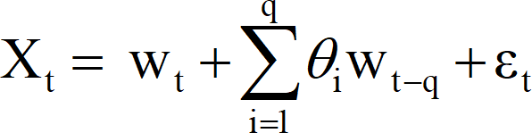
Statistical Methods for Data Science
Time Series Moving Average (MA) Model
Moving-average model of order q (MA(q)):
where: θ₁, θ₂, . . . , θ_{q} are constants with θ_{q} ≠ 0; and w_{t}
is Gaussian white noise w_{t} (0, σ² ).
w
Note: Gaussian noise, named after Carl Friedrich Gauss, is statistical noise having a probability density function (PDF) equal to that of the normal distribution, which is also known as the Gaussian distribution. In other words, the values that the noise can take on are Gaussian distributed.

Slide 72
Statistical Methods for Data Science
Time Series
Autoregressive Moving Average (ARMA) Model
Autoregressive–moving-average model. In the statistical analysis of time series Auto-Regressive Moving Average (ARMA) models provide a parsimonious description of a (weakly) stationary stochastic process in terms of two polynomials, one for the autoregression (AR) and the second for
the moving average (MA).

Slide 73
Statistical Methods for Data Science
Time Series
Autoregressive Moving Average (ARMA) Model
The AR and MA models dynamics can be combined into what is called an autoregressive moving-average (ARMA) model.
The ARMA (1, 1) is
𝑌_{𝑡} = 𝜙₋ + 𝜙₁𝑌_{𝑡$1} + 𝜃₁𝜖_{𝑡$1} + 𝜖_{𝑡}
𝜙₀ – Constant term in AR model
𝜙₁ – Coefficient associated with Y_{t-1} in AR model
𝜃₁ – Coefficient associated with 𝜖_{t-1} in MA model
𝜖_{t-1} – Error while measuring Y_{t-1} in MA model
𝜖_{t} – Error while measuring Y_{t} in MA model

Slide 74
Statistical Methods for Data Science
Time Series
Autoregressive Moving Average (ARMA) Model
The predicted value for the ARMA (1, 1) is
^{𝑌9}𝑡 ^{= 𝜙}) ^{+ 𝜙}$^{𝑌}𝑡%$ ^{+ 𝜃}$^{𝜖}𝑡%$
Here 𝜙₀, 𝜙_{1,} and 𝜖_{t-1} are all known except 𝜖_{t} – the error of the current
time
With the help of ACF which helps to identify the MA order and PCAF
helps to identify the AR model the ARMA (p, q) model is given by

Slide 75
Statistical Methods for Data Science
Time Series
Autoregressive Moving Average (ARMA) Model
The ACF and PACF are one of the many ways to use to decide the order of ARMA model
ACF
MA order is 2
PACF
AR order is 1

Slide 76
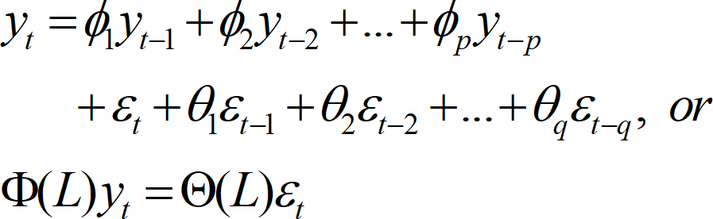
Statistical Methods for Data Science
Time Series
Autoregressive Moving Average (ARMA) Model
Higher order ARMA processes involve additional lags of X and epsilon.
The ARMA (p, q) is

Slide 77
Statistical Methods for Data Science
Time Series
Autoregressive Integrated Moving Average (ARIMA) Model
ARIMA is an acronym that stands for Auto-Regressive Integrated Moving Average. Specifically,
AR Auto-regression: A model that uses the dependent relationship an observation and some number of lagged observations
I Integrated: The use of differencing of raw observations in order to make the time series stationary
MA Moving Average: A model that uses the dependency between an observation and residual error from a moving average model applied to lagged observations

Slide 78
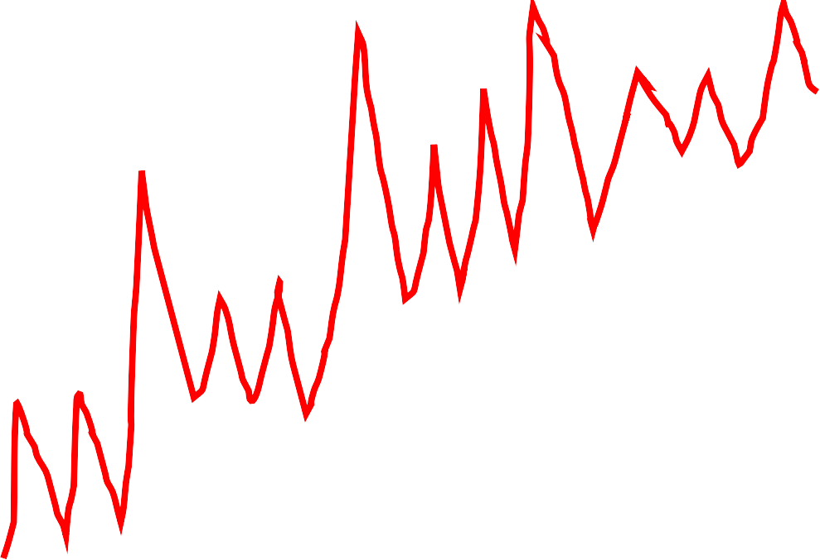
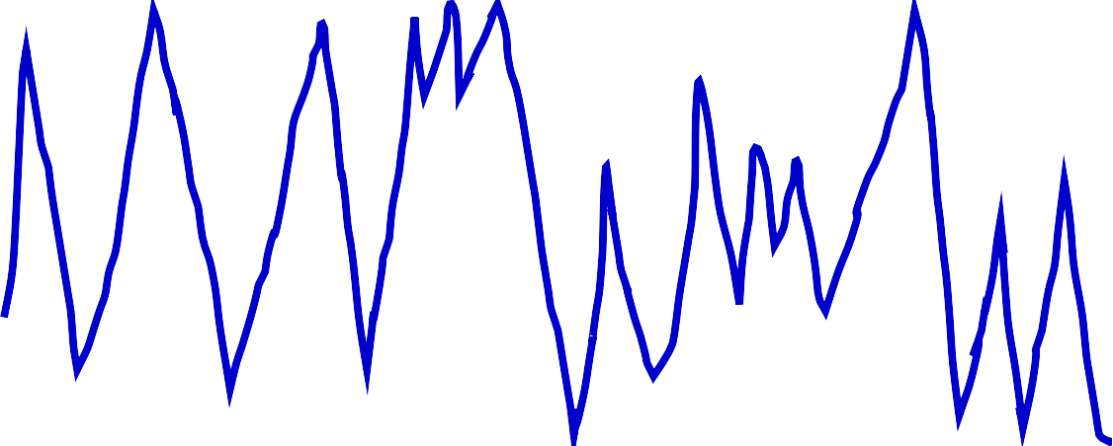
ARMA model
Y_{t}
ARIMA model
Z_{t}
t
t
Non-stationary – Mean not same
Stationary – Mean same
𝑘%𝑙
𝑌_{𝑘} = : 𝑍_{𝑘%+} + 𝑎_{𝑙}
+,$
The Stationary model now is

Slide 79
Statistical Methods for Data Science
Time Series
Autoregressive Integrated Moving Average (ARIMA) Model
Let Y_{t}, Y_{t-1}, Y_{t-2}, …, Y_{t-p} are the ‘p’ non-stationary time series data.
Define Z_{t} = Y_{t+1} – Y_{t} be the first order differencing between two successive values.
The Z_{t} will now be transformed into stationary data

Slide 80
Statistical Methods for Data Science
Time Series
Autoregressive Integrated Moving Average (ARIMA) Model
Each of these are explicitly specified in the model as a parameter.
Note that AR and MA are two widely used linear models that work on stationary time series and I is a pre-processing to stationarize time series if needed.

Slide 81
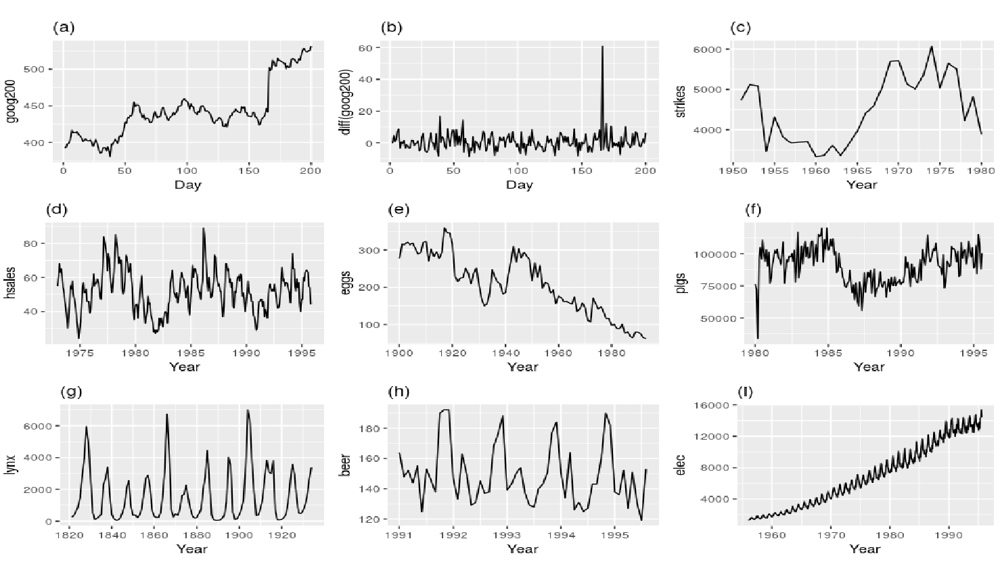
Statistical Methods for Data Science
Time Series Stationary Stochastic Process in Time series

Slide 82
Statistical Methods for Data Science
Time Series
Autoregressive Integrated Moving Average (ARIMA) Model
Rationale - The first task is to provide a reason why we're interested in a particular model, as quants. Why are we introducing the time series model? What effects can it capture? What do we gain (or lose) by adding in extra complexity?
Definition - We need to provide the full mathematical definition (and associated notation) of the time series model in order to minimise any ambiguity

Slide 83
Statistical Methods for Data Science
Time Series Choice of p, d and q
Second Order Properties - We will discuss (and in some cases derive) the second order properties of the time series model, which includes its mean, its variance and its autocorrelation function
Correlogram - We will use the second order properties to plot a correlogram of a realisation of the time series model in order to visualise its behaviour.

Slide 84
Statistical Methods for Data Science
Time Series Choice of p, d and q
Simulation - We will simulate realisations of the time series model and then fit the model to these simulations to ensure we have accurate implementations and understand the fitting process.

Slide 85
Statistical Methods for Data Science
Time Series Choice of p, d and q
Look at autocorrelation graph of data (will help if MA model is appropriate).
Look at partial autocorrelation graph of data (will help if MR model is appropriate).
Look at extended autocorrelation chart of data (will help if a combination of MA and AR models is needed).

Slide 86
Statistical Methods for Data Science
Time Series Choice of p, d and q
Try Akaike’s information criterion (AIC) on a set of models and investigate the models with the lowest AIC values
Try the Schwartz Bayesian information criterion (BIC) and investigate the models with the lowest BIC values
All the above criterion to choose p, d and q are available as package in R.

Slide 87
Statistical Methods for Data Science
Time Series SARIMA model
Autoregressive Integrated Moving Average, or ARIMA, is one of the most widely used forecasting methods for univariate time series data forecasting.
Although the method can handle data with a trend, it does not support time series with a seasonal component.
An extension to ARIMA that supports the direct modeling of the seasonal component of the series is called Seasonal Autoregressive Integrated Moving Average model (SARIMA).

Slide 88
Statistical Methods for Data Science
Time Series SARIMAX model
SARIMAX(Seasonal Auto-Regressive Integrated Moving Average with eXogenous factors) is an updated version of the ARIMA model. ARIMA includes an autoregressive integrated moving average, while SARIMAX includes seasonal effects and eXogenous factors with the autoregressive and moving average component in the model.

Slide 89
Statistical Methods for Data Science
Time Series VAR and VARMAX models
VAR models (vector autoregressive models) are used for multivariate time series. The structure is that each variable is a linear function of past lags of itself and past lags of the other variables in the system.
The VARMAX procedure enables you to model the dynamic relationship both between the dependent variables and also between the dependent and independent variables. VARMAX models are defined in terms of the orders of the autoregressive or moving- average process (or both).

Slide 90
Reference
Peter J Brockwell and Richard A Davis. Introduction to Time Series and Forecasting, 2/e, Springer
Douglas C. Montgomery, and Cheryl L. Jennings, Murat Kulahcin. Introduction to Time Series Analysis and Forecasting, 2/e, Wiley

Slide 91
